Slide 1
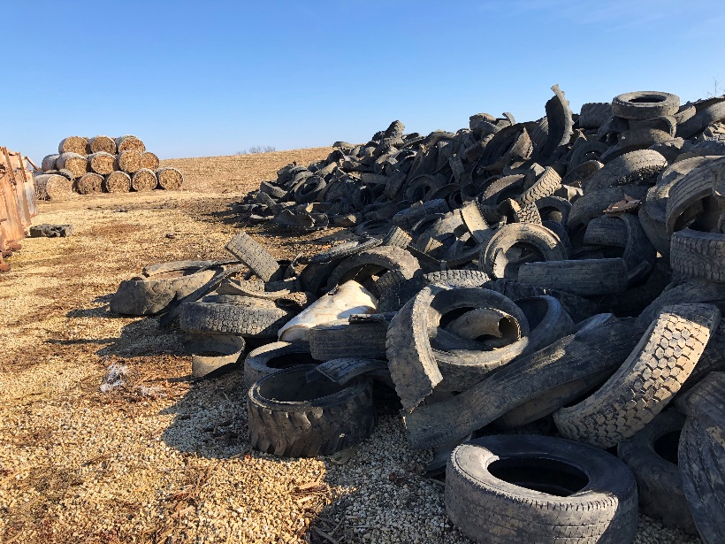
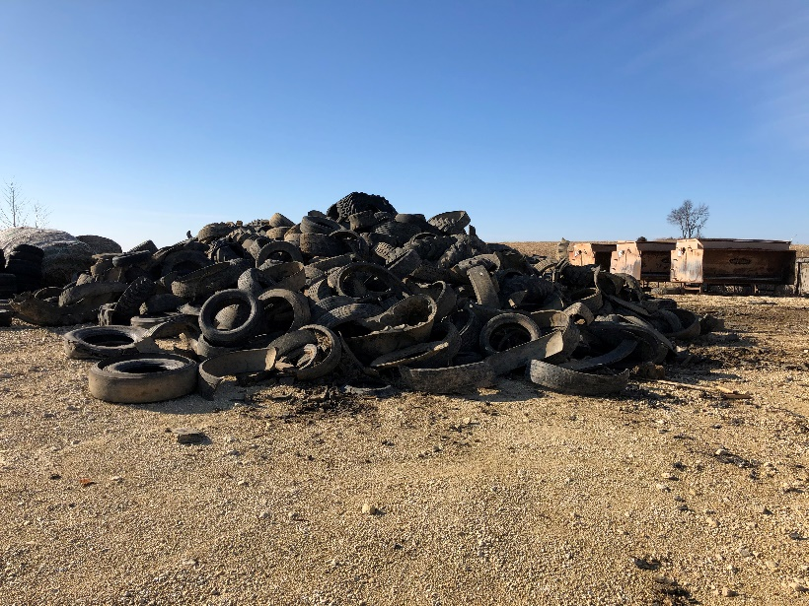
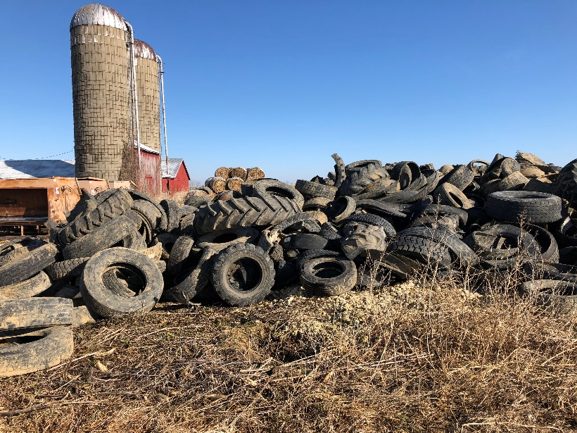
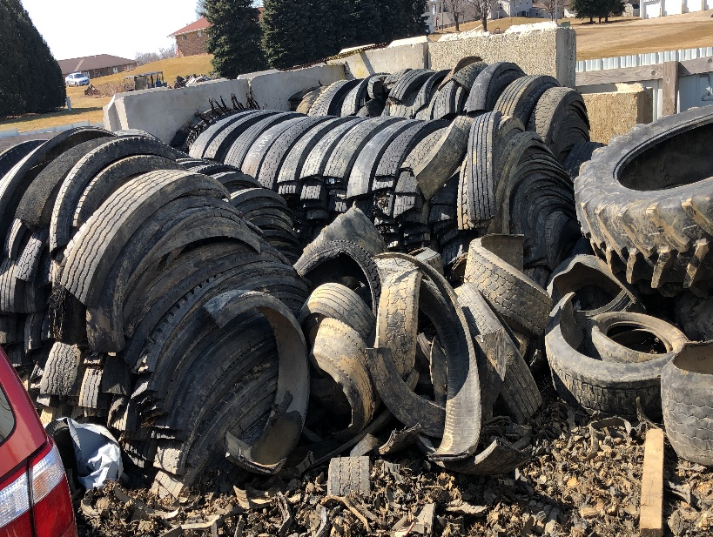
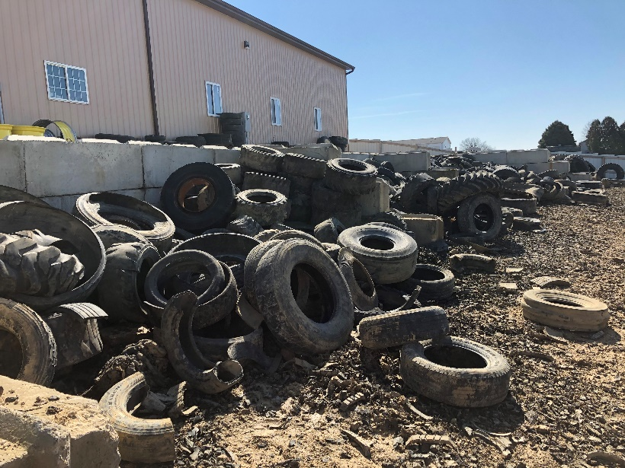
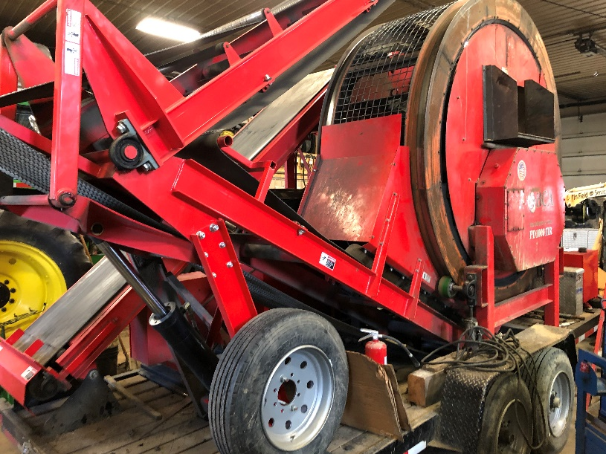
Photos of the 03/10/20 JR Recycling tire moving and storage violations field investigation, Dubuque and Jackson Counties page 1 of 1.
Photo 1
Photo 2
Photo 3
Photo 4
Photo 5
Photo 6

Slide 2
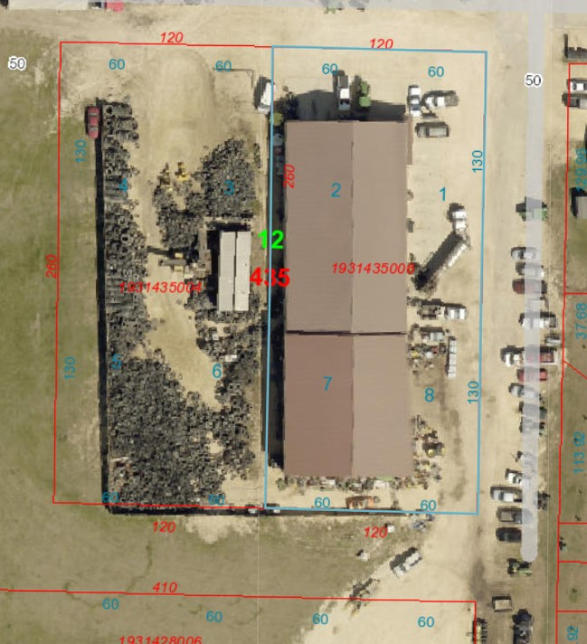
Figure 1. JR Recycling, aerial photo

