Slide 1
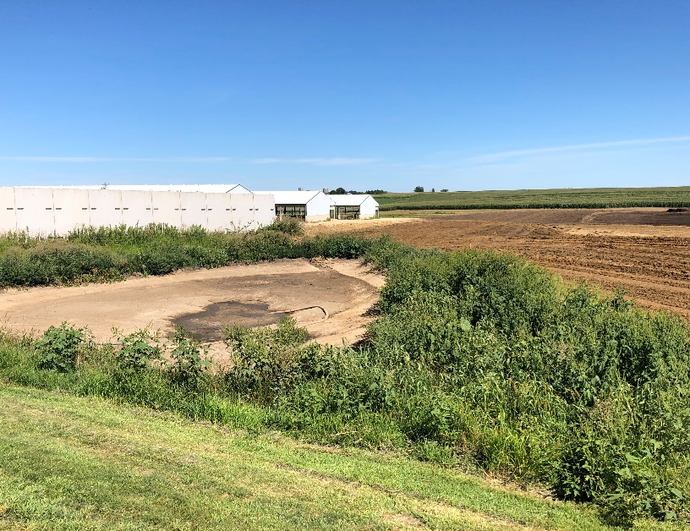
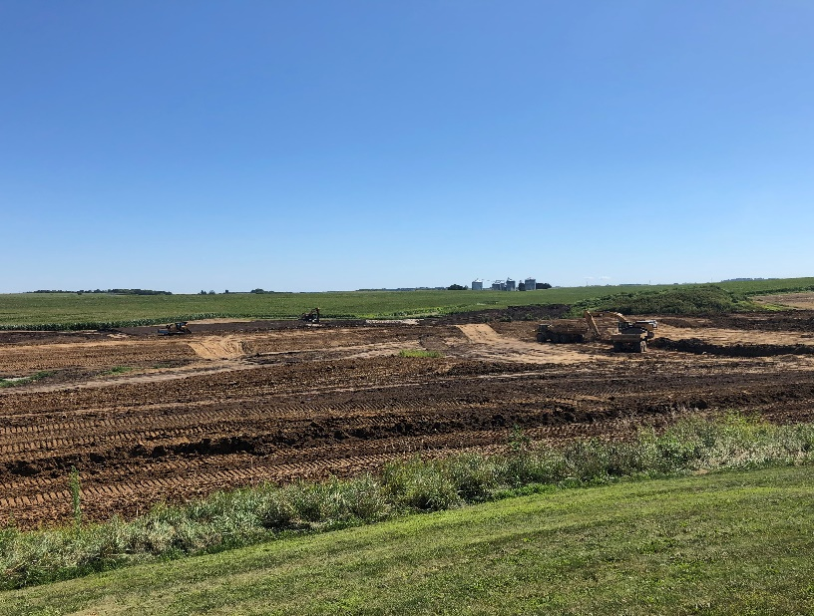
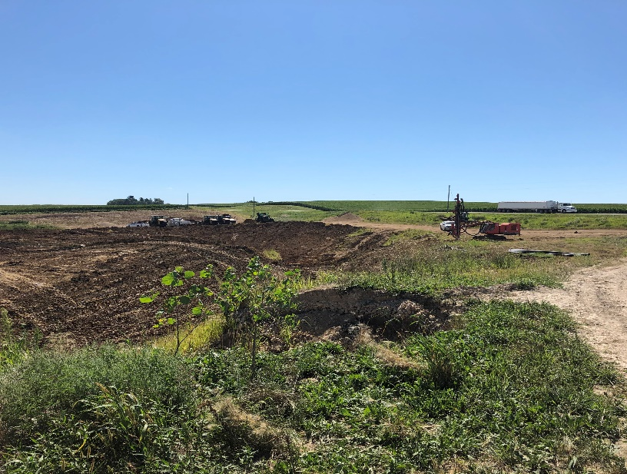
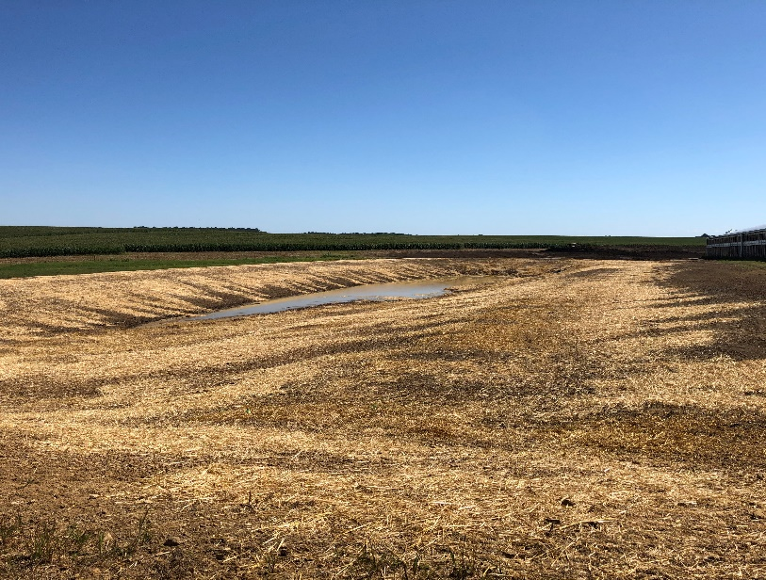
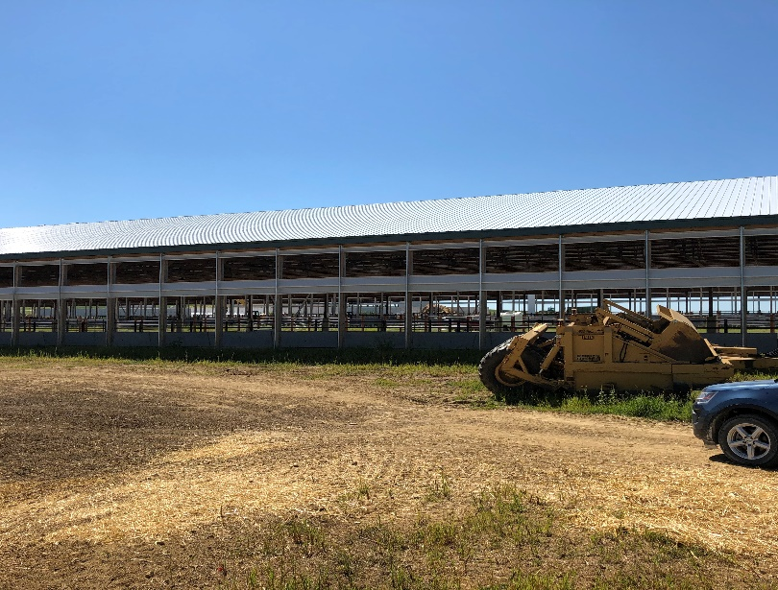
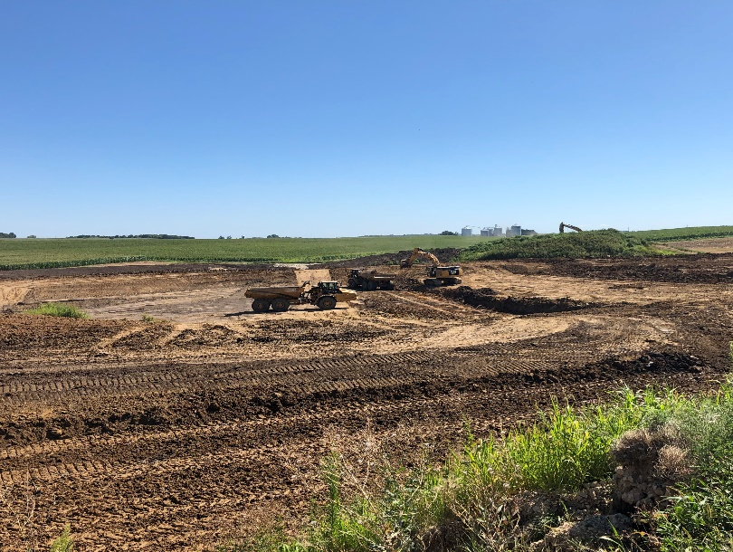
Photos of Walz Energy August 19 2020, page 1 of 1.
Photo 1. Lower food storage basin removed. Upper food storage basin pumped out, looking northwest.
Photo 2. Looking northeast, roughly towards Bloody Run Creek.
Photo 3. looking east towards Hwy. 18. Most of the construction area was being disturbed.
Photo 4. Covered stormwater basin north of cattle buildings, looking east.
Photo 5. Stormwater control around cattle buildings, Other work on buildings was in progress. Looking SE.
Photo 6. Construction of large wastewater lagoon, looking east.

